Slide 1
Meet One of the Founding Fathers
Benjamin Franklin
Notes:
Interesting Facts about Benjamin Franklin

Slide 2
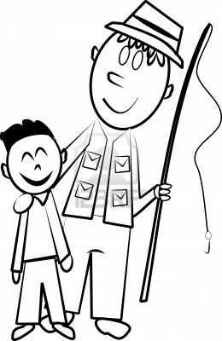

Notes:
His father made soap for the American people

Slide 3
17
15
1 2 3 4 5 6 7 8 9 10 11 12 13 14
16 17
Notes:
17 Brothers and Sisters
Benjamin was 15th in the order or brothers and sisters

Slide 4
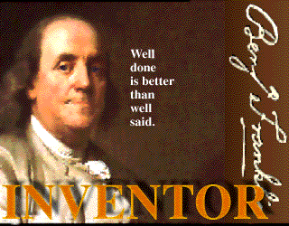
“Well done is better than well said”
Notes:
He was an inventor

Slide 5
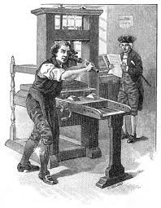





Printing Press
Notes:
Printing Press

Slide 6
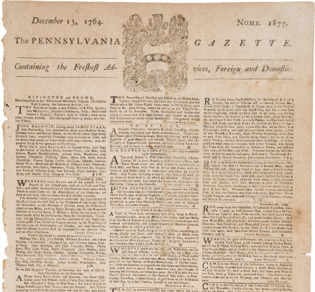
Notes:
First Newspaper

Slide 7
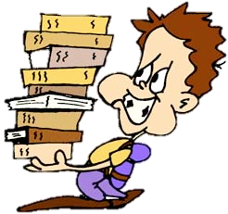

1st Public Library
Notes:
First Library in 1731

Slide 8
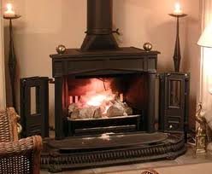
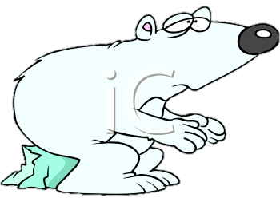
Thanks Ben!
Notes:
Pennsylvania Heat Stove or the Fire Place Known as the Franklin Stove

Slide 9
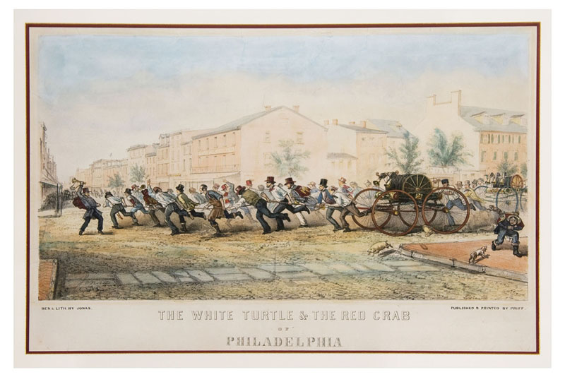
Notes:
First Volunteer Fire Department
What do you notice about the fire truck
Men pullin, clothes, etc….

Slide 10
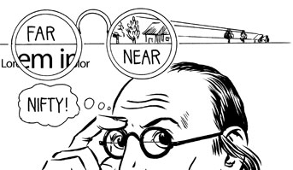
Bifocals
Notes:
Invented the Bifocals

Slide 11
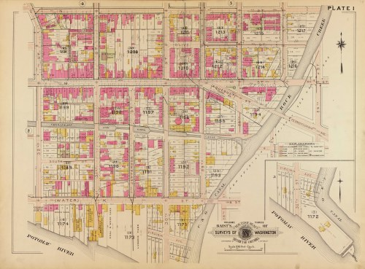

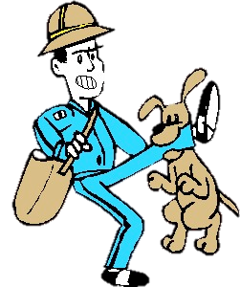
Mapmaker
Notes:
Mapmaker for the Mailman

Slide 12
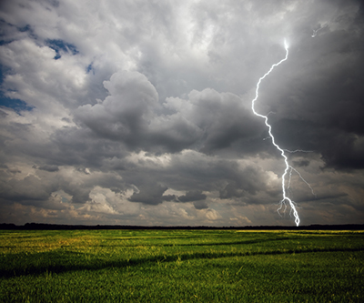
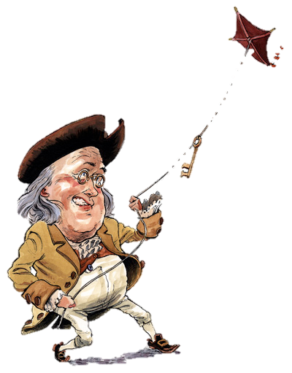
Notes:
He discovered electricity by flying a kite in a thunderstorm

Slide 13
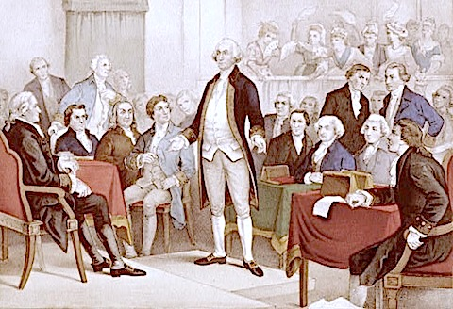
Wow! He should be our first President…
Notes:
One of the founding fathers

Slide 14
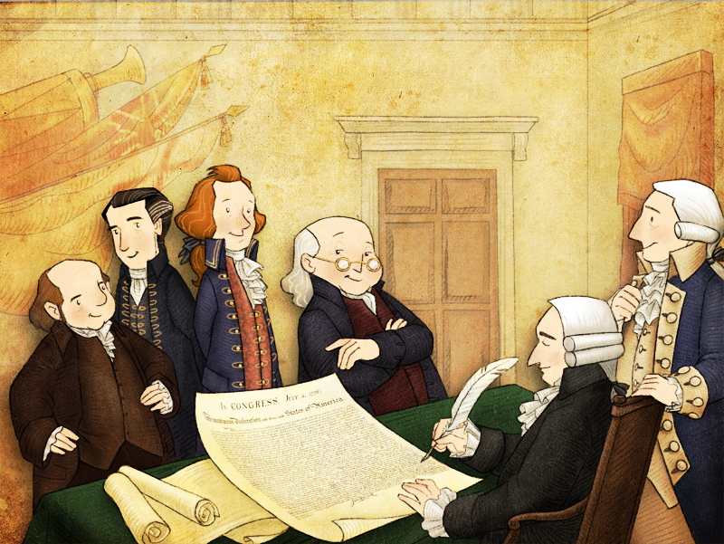
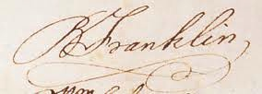
Notes:
Signed the Declaration of Independence

Slide 15
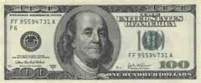
100
100
100
100
100
100
100
100
100
100
100
100
100
100
100
100
100
100
100
100
100
Notes:
He is on the 100 dollar bill

Slide 16
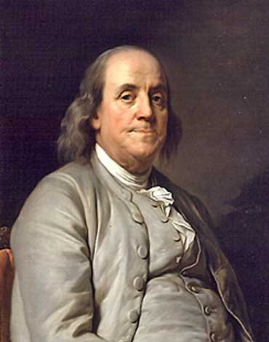
Benjamin
Franklin
Inventor
Founding Father
World Famous
Notes:
World Famous

